Slide 1

A Real-Time Human Computer Interaction using Hand Gestures in OpenCV
Amrita School of Computing, Bangalore Campus
Department of Computer Science and Engineering
21AIE495 – Project Phase – 1
Group Number – 10
Name Registration Number
1. K. Vishnu Sainadh BL.EN.U4AIE19028
2. K. Satwik BL.EN.U4AIE19034
3. V. Ashrith BL.EN.U4AIE19066
Guide Name: Niranjan D K
Designation: Lecturer
Department of CSE, ASC, Bangalore
Notes:
Good afternoon everyone and my teammates our project title is a real time human computer interaction using hand gestures in openCV

Slide 2
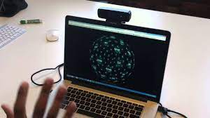
Contents
Abstract
Introduction
Motivation
Objective
Problem Statement
Summary of Literature Survey
Software/Tools Requirements
Architecture
Testing
Results
Conclusion and Future Scope
References
Notes:
This is what we are going to discuss in today’s presentation we start from abstract of the project and then we go until the project plan

Slide 3
Abstract
In today's world, with the development of new and emerging technologies and devices during the past ten years, the trends in human-computer interaction have undergone a significant transformation. Human-Computer Interaction (HCI) is the way that people and computers talk to each other. Generally, computers have been used with a mouse and a keyboard. Using hand gestures to communicate with computers is a new way to interact with computers. Computer Vision techniques will be used in our project to create a virtual mouse and keyboard that can read hand gestures .
People with different disabilities can't use the computer with the way it is set up now. Our project aims to solve this problem. Our project is a GUI based application, and with the assistance of computer vision techniques, user hand motions (gestures) is implemented in real-time to operate mouse and keyboard of our computer and custom gestures are being used to make certain actions.
Notes:
In the past ten years, new technology and devices have transformed human-computer interaction trends. HCI is how humans and computers communicate. Most computers feature a mouse and keyboard. We'll utilise computer vision to develop a virtual mouse and keyboard that reads hand motions.
Disabled people can't utilise the computer as-is. Our project solves this. Our project is a programme that uses computer vision to implement user hand motions (gestures) in real-time to operate the mouse and keyboard. Custom gestures are utilised to do certain activities.

Slide 4
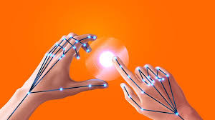
Introduction
Nowadays computer vision has reached its pinnacle, where a computer can identify its owner using a simple program of image processing.
In this stage of development, people are using this vision in many aspects of day-to-day life, like Face Recognition, Color detection, Automatic car, etc.
Researchers from all over the world are currently working to increase the interactivity of our devices and to develop ways to operate them virtually.
Notes:
A computer can now identify its owner using an image-processing application.
At this time, individuals use this vision for Face Recognition, Color Detection, Automatic Cars, etc.
Global researchers are working to make our electronics more interactive and virtual.
And with our project we move one-step closer towards the latest trends in computer vision applications.

Slide 5
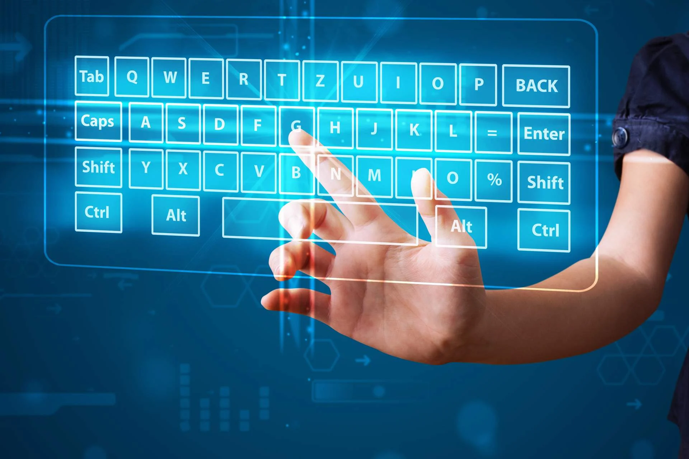
Motivation
To help make the lives of people with different disabilities easier to interact with computer.
Also, in Covid Situation many people don’t want to touch stuff that’s related to Covid or in other way we can tell that there should be minimal contact.
It is also economical, doesn’t require more space and is convenient for the users.

Slide 6
Objective
Our main goal is to make the interaction between human and computer as natural as the interaction between humans.
The purpose of this project is to develop a Virtual Keyboard and Mouse application that targets a few aspects of significant development.

Slide 7
Problem Statement
Creating a Real-time virtually controlled mouse and keyboard using hand gestures which helps in achieving the ease and naturalness desired for HCI.

Slide 8
Literature Survey
Paper Title | Author | Description | Gaps
Hand Gesture Tracking and Recognition based Human-Computer Interaction System and Its Applications IEEE International Conference on Information and Automation (ICIA) 2018. | Kai Li; Jun Cheng; Qieshi Zhang; Jianming Liu | Proposed a human-computer interaction (HCI) system for entertainment or education via a depth-sensing camera. Used Kalman filter and depth data from the Kinect to predict the hand position making the tracking smooth and robust. | Only static gestures are supported, restrictions on the multi-hand tracking and recognition, Custom gestures mapped to certain actions (shortcuts).

Slide 9
Literature Survey Cont..
Paper Title | Author | Description | Gaps
Gesture Recognition Based Virtual Mouse and Keyboard 4th International Conference on Trends in Electronics and Informatics (ICOEI)(48184) 2020 | Sugnik Roy Chowdhury; Sumit Pathak; M.D. Anto Praveena | In this project, computer vision is used in creating an Optical mouse and keyboard using hand gestures. The process of skin segmentation is utilized to separate the colour/image of hand with its background. | Mouse clicks are not intuitive, Custom gestures mapped to certain actions (shortcuts).

Slide 10
Literature Survey Cont..
Paper Title | Author | Description | Gaps
Controlling Media Player with Hand Gestures using Convolutional Neural Network IEEE Mysore Sub Section International Conference (MysuruCon) 2021 | Gayathri Devi Nagalapuram; Roopashree S ; Varshashree D ;Dheeraj D ; Donal Jovian Nazareth | They proposed a system where hand gestures with the help of Computer vision and deep learning are used to control a media player. They have used a predefined set of 7 gestures and proposed a GUI which enables the user to use their local device camera to identify their gesture and execute the control over the media player and similar applications | Only works for a specific application, Custom gestures mapped to certain actions (shortcuts).
Notes:
They proposed a system where hand gestures with the help of Computer vision and deep learning are used to control a media player. They have created a datset of 7 gestures with 150 images each. They have also created a custom CNN arch. The major research gap we identified here is that it only works for a specific application ie it is application oriented so It works only with the media player and not others and also this application works only In the specific bounding box shown in the GUI

Slide 11
Literature Survey Cont..
Paper Title | Author | Description | Gaps
HandKey: An Efficient Hand Typing Recognition using CNN for Virtual Keyboard 5th International Conference on Information Technology (InCIT), 2020. | Avirmed Enkhbat; Timothy K. Shih; Tipajin Thaipisutikul; Noorkholis Luthfil Hakim; Wisnu Aditya | They presented an efficient hand typing motion recognition system for Virtual Keyboard using a single RGB camera. The recognition part uses MHI for feature extraction and classify data using CNN. | Virtual mouse is absent, Custom gestures mapped to certain actions (shortcuts).
Notes:
They proposed an efficient hand typing motion recognition system for Virtual Keyboard. The recognition part uses motion history Image technique for feature extraction and classify data using vgg-16 CNN model.
This paper has 2 models one for recognizing the touch and non touch and the other is for recognizing which finger is moving.

Slide 12
Literature Survey Cont..
Paper Title | Author | Description | Gaps
A Dynamic Hand Gesture Recognition Model Based on the Improved Dynamic Time Warping Algorithm 25th International Conference on Automation & Computing, Lancaster University, Lancaster UK 2019 | Li, Yi and Feng, Xuan and Xu, Yuanping and Dong, Xude and Xu, Zhijie and Huang, Jian and Lu | They proposed a study that uses an integrated dynamic hand gesture recognition model based on the improved DTW (Dynamic Time Warping) algorithm | Only Dynamic gestures are supported, Custom gestures mapped to certain actions (shortcuts).
Notes:
The proposed model extracts the dynamic gesture motion regions by applying the three frame difference method, and then the motion trajectories of dynamic gestures can be extracted from these motion regions according to the calculated centroids. Finally, the improved DTW algorithm is applied for template matching to classify dynamic hand gestures

Slide 13
Literature Survey Cont..
Paper Title | Author | Description | Gaps
System application control based on Hand gesture using Deep learning 7th International Conference on Advanced Computing and Communication Systems (ICACCS) 2021 | Niranjani V, Keerthana R, Mohana Priya B, Nekalya K, Anantha Krishnan Padmanabhan | They proposed a deep convolutional neural network (DCNN) to use hand gestures recognition and immediately classify them by preserving even the not-hand area without any detection or segmentation process. | Only works for a specific application, Custom gestures mapped to certain actions (shortcuts).

Slide 14
Literature Survey Cont..
Paper Title | Author | Description | Gaps
Ambidextrous Virtual Keyboard Design with Finger Gesture Recognition IEEE International Symposium on Circuits and Systems (ISCAS) 2018. | Tae-Ho Lee, Hyuk-Jae Lee | They defined an objective function to formulate the type-in time and proposed an algorithm to design a keyboard layout that minimizes the input time. | The keyboard pattern is frequently changed, Custom gestures mapped to certain actions (shortcuts).

Slide 15

Summary of Literature Survey
Gaps Identified
The majority of the papers were application-focused.
Restricted number of operations were implemented.
Restrictions on the multi-hand tracking and recognition.

Slide 16
Software/Tools Requirement
Software
OpenCV – Front End
Python 3.0 or higher – Back End
PyAutoGUI Library
MediaPipe Library
AutoPy Library
Hardware
Windows 10 or higher
Camera - inbuilt or external
I3 processor or higher
Ram 4 GB - Minimum

Slide 17
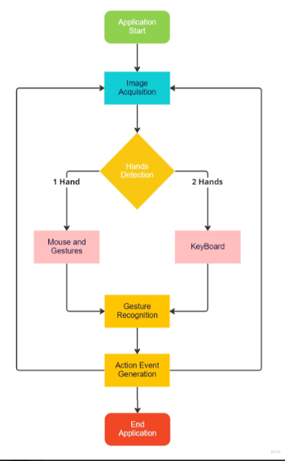
Architecture

Slide 18
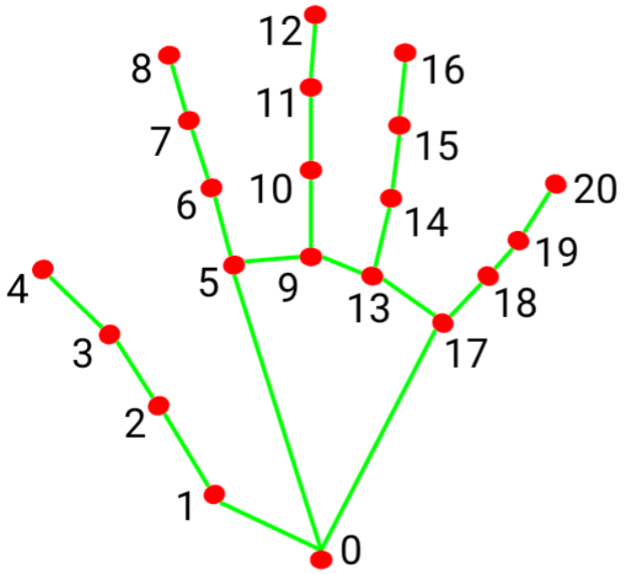
Testing
Initially we tested our application to recognize left hand and right hand.
The 21 points on a palm which refer to specific locations on the hand that can be tracked
we used these 21 points to create multiple gestures and assigned them an action.

Slide 19
Results

Slide 20
Results

Slide 21
Results

Slide 22
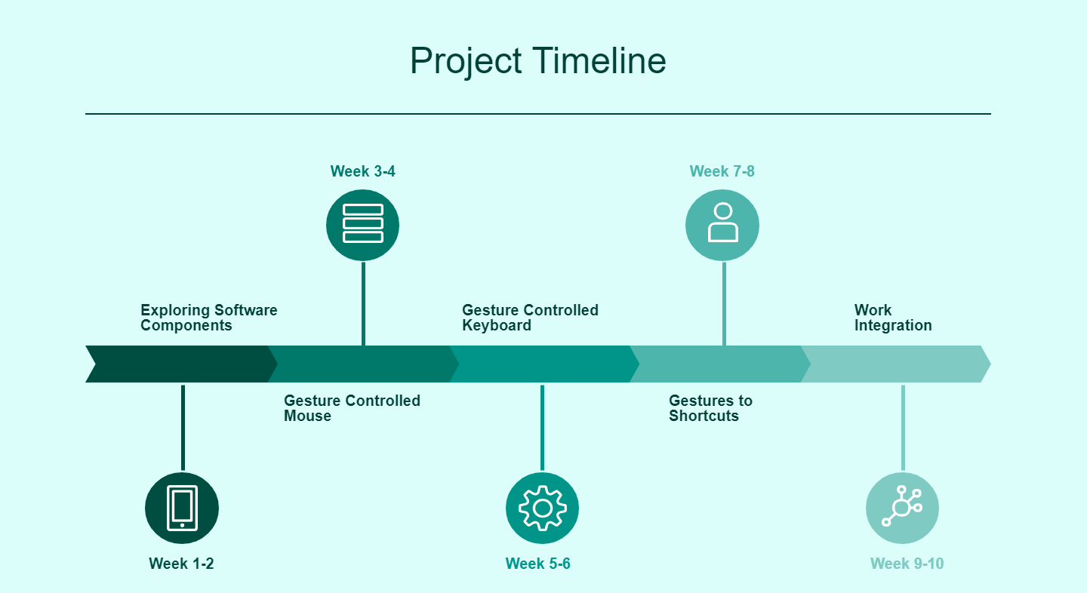

Slide 23
Conclusion and Future Scope
We achieved a real-time human computer interaction using hand gestures by implementing virtual mouse and keyboard along with some custom gestures mapped to certain actions.
Overall, the project has shown that hand gestures can be an effective and efficient alternative to traditional input methods such as a keyboard or mouse.
The human computer interaction can be integrated with a hand glove which has sensors so it helps to sense the gesture the user has used.
The system can be designed to be more adaptable and flexible to different users by adapting to the user's gestures and preferences over time.

Slide 24
Status of the project work Publication

Slide 25
References
K. Li, J. Cheng, Q. Zhang and J. Liu, "Hand Gesture Tracking and Recognition based Human-Computer Interaction System and Its Applications”, IEEE International Conference on Information and Automation (ICIA), 2018.
S. R. Chowdhury, S. Pathak and M. D. A. Praveena, "Gesture Recognition Based Virtual Mouse and Keyboard”, 4th International Conference on Trends in Electronics and Informatics (ICOEI)(48184), 2020.
G. D. Nagalapuram, R. S, V. D, D. D and D. J. Nazareth, "Controlling Media Player with Hand Gestures using Convolutional Neural Network”, IEEE Mysore Sub Section International Conference (MysuruCon), 2021.
A. Enkhbat, T. K. Shih, T. Thaipisutikul, N. L. Hakim and W. Aditya, "HandKey: An Efficient Hand Typing Recognition using CNN for Virtual Keyboard“, 5th International Conference on Information Technology (InCIT), 2020.
Y. Li et al., "A Dynamic Hand Gesture Recognition Model Based on the Improved Dynamic Time Warping Algorithm," 2019 25th International Conference on Automation and Computing (ICAC), 2019.
V. Niranjani, R. Keerthana, B. Mohana Priya, K. Nekalya and A. K. Padmanabhan, "System application control based on Hand gesture using Deep learning”, 7th International Conference on Advanced Computing and Communication Systems (ICACCS), 2021.
T. -H. Lee and H. -J. Lee, "Ambidextrous Virtual Keyboard Design with Finger Gesture Recognition," IEEE International Symposium on Circuits and Systems (ISCAS), 2018.

Slide 26
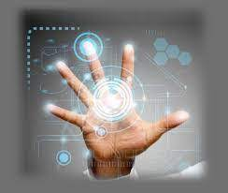
Thankyou

